Slide 1


Classification using Decision Trees and RF Week 2
Machine Learning for Data Analysis MSc in Data Analytics CCT College Dublin
Lecturer: Dr. Muhammad Iqbal*
Email: miqbal@cct.ie
©CCT College Dublin 2022

Slide 2
Agenda
Classification and Regression
Classification Methods and Examples
Structure of Hunt’s Algorithm
Measures of Node Impurity
Calculation of Gini Index and Error
Comparison of Impurity Measures
Misclassification Error vs Gini Index
Advantages and Disadvantages of Decision Tree Based Classification
Ensemble Classifiers
Random Forest and Algorithm

Slide 3
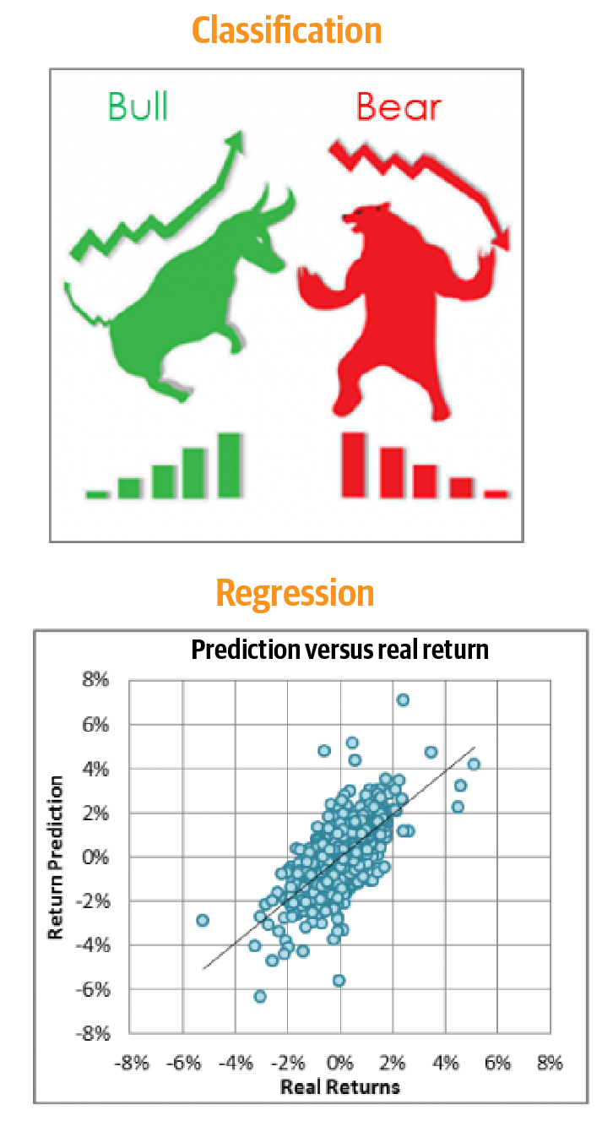
Classification and Regression
Classification
Classification is a subcategory of supervised learning in which the goal is to predict the categorical class labels of new instances based on past observations.
Regression
Regression is another subcategory of supervised learning used in the prediction of continuous outcomes. In regression, we are given a number of predictor (explanatory) variables and a continuous response variable (outcome or target), and we try to find a relationship between those variables that allows us to predict an outcome.

Slide 4
Classification Methods
Given a collection of records (training set)
Task:
Learn a model that maps each attribute set x into one of the predefined class labels y.
Each record is characterized by a tuple (x, y), where x is the attribute set and y is the class label
x: attribute, predictor, independent variable, input
y: class, response, dependent variable, output
Base Classifiers
Decision Tree based Methods
Rule-based Methods
Nearest-neighbor
Neural Networks
Naïve Bayes and Bayesian Belief Networks
Support Vector Machines
Ensemble Classifiers
Boosting, Bagging, Random Forests
Notes:
Rule-based machine learning approaches include learning classifier systems, association rule learning, artificial immune systems, and any other method that relies on a set of rules, each covering contextual knowledge.
A Bayesian network is a probabilistic graphical model that represents a set of variables and their conditional dependencies via a directed acyclic graph.

Slide 5
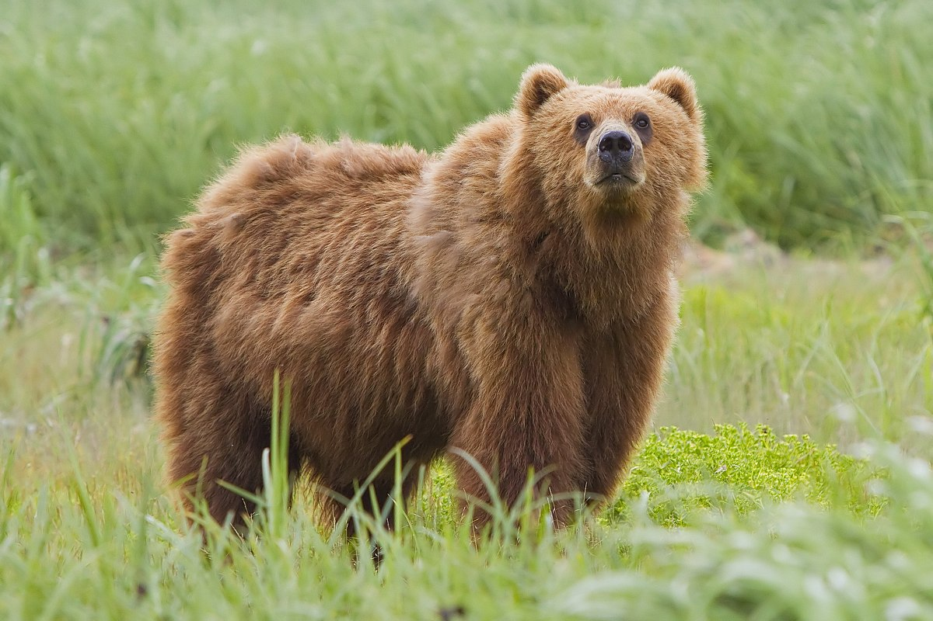


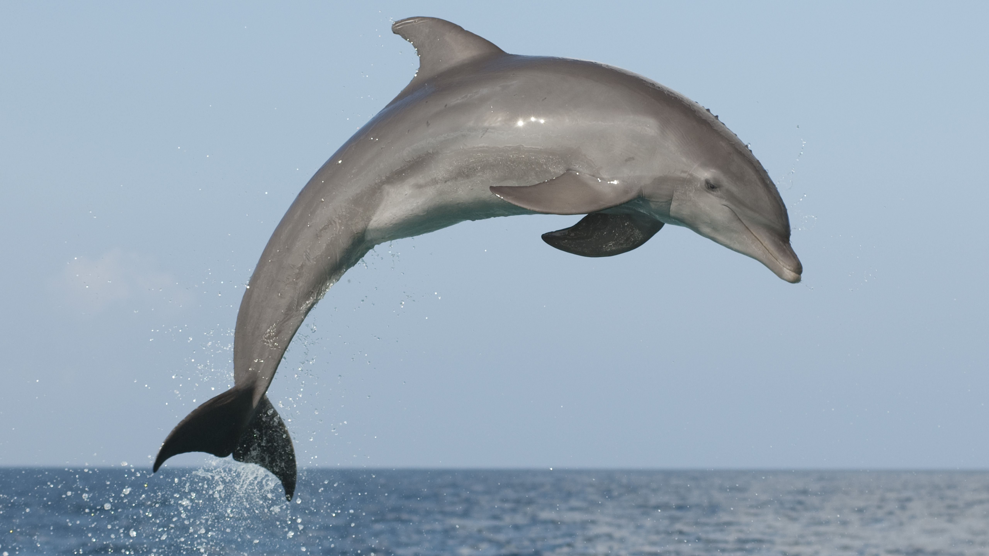
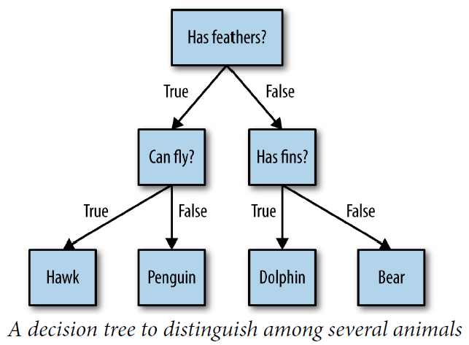
Classification Example
Decision trees are widely used models for classification and regression tasks. They learn a hierarchy of if/else questions, leading to a decision.
These questions are similar to the questions that you might ask in a game of 20 Questions.
Suppose you want to distinguish between the following four animals: bears, hawks, penguins, and dolphins.
Your goal is to get to the right answer by asking as few if/else questions as possible. You might start off by asking whether the animal has feathers, a question that narrows down your possible animals to just two.
If the answer is “yes,” you can ask another question that could help you to distinguish between hawks and penguins.
For example, you could ask whether the animal can fly. If the animal doesn’t have feathers, your possible animal choices are dolphins and bears, and you will need to ask a question to distinguish between these two animals. For example, asking whether the animal has fins.
In this illustration, each node in the tree either represents a question or a terminal node (also called a leaf) that contains the answer.
The edges connect the answers to a question with the next question you would ask.

Slide 6
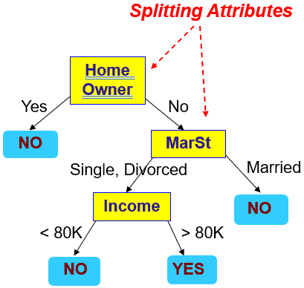
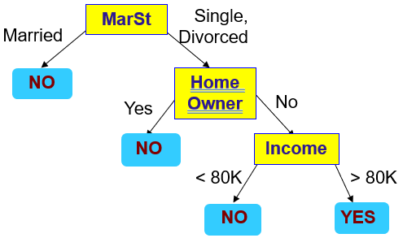
Decision Trees Examples
Model: Decision Tree
Can you determine the chances of new customer’s default or not based on Home Owner, Martial Status and Annual Income features?
categorical
categorical
continuous
class
First possible Decision Tree
2nd possible Decision Tree
Training Data
There could be more than one tree that fits the same data!
Notes:
Categorical data: Categorical data represent characteristics such as a person’s gender, marital status, hometown, or the types of movies they like. Categorical data can take on numerical values (such as “1” indicating male and “2” indicating female), but those numbers don’t have mathematical meaning. You couldn’t add them together, for example. (Other names for categorical data are qualitative data, or Yes/No data.)
Ordinal data mixes numerical and categorical data. The data fall into categories, but the numbers placed on the categories have meaning. For example, rating a restaurant on a scale from 0 (lowest) to 4 (highest) stars gives ordinal data. Ordinal data are often treated as categorical, where the groups are ordered when graphs and charts are made. However, unlike categorical data, the numbers do have mathematical meaning. For example, if you survey 100 people and ask them to rate a restaurant on a scale from 0 to 4, taking the average of the 100 responses will have meaning. This would not be the case with categorical data.

Slide 7
Apply Model to Test Data
Test Data
Home Owner
Assign Defaulted to “No”
Yes
No
Many Algorithms:
Hunt’s Algorithm (one of the earliest)
CART (Classification and Regression Trees) is similar to C4.5.
ID3, C4.5
SLIQ, SPRINT
NO
MarSt
Single, Divorced
Married
Income
NO
< 80K
> 80K
NO
YES
Notes:
Hunt’s Algorithm: A decision tree is grown in a recursive fashion by partitioning the training records into successively purer subsets.
Classification and Regression Tree (CART): It constructs the tree using binary splitting, which we will discuss in detail shortly.
Iterative Dichotomiser 3 (ID3): This algorithm uses a greedy search in a top-down manner by selecting the best attribute to split the dataset on each iteration without backtracking.
C4.5: An improved version on ID3 that introduces backtracking; it traverses the constructed tree and replaces branches with leaf nodes if purity is improved this way.
CHi-squared Automatic Interaction Detector (CHAID): This algorithm is used in direct marketing. It involves complicated statistical concepts, but basically determines the optimal way of merging predictive variables in order to best explain the outcome.
SLIQ: A Fast Scalable Classifier for Data Mining

Slide 8
Structure of Hunt’s Algorithm
We can develop decision trees in a recursive fashion using a Hunt's algorithm.
The training dataset is successively partitioned until form the purer subsets. Let D_{t} be the set of training records that reach a node t.
The general recursive procedure is defined as below
Methodology:
If D_{t} contains records that belong to the same class y_{t}, then t is a leaf node labeled as y_{t}
If D_{t} is an empty set, then t is a leaf node labeled by the default class as y_{d}
If D_{t} contains records that belong to more than one class, use an attribute test to split the data into smaller subsets. Recursively apply the procedure to each subset.
D_{t}
?

Slide 9
Hunt’s Algorithm
(7,3)
(3,0)
(4,3)
Stop the Split Procedure
A stopping condition is needed to terminate the tree-growing process.
One approach is to keep growing a node until all of the records are either members of the same class or have the same attribute values.
Despite the fact that there are enough circumstances for the decision tree induction technique to stop, some algorithms also use additional criteria to end the tree-growing process earlier.
(3,0)
(3,0)
(3,0)
(1,3)
(3,0)
(1,0)
(0,3)

Slide 10
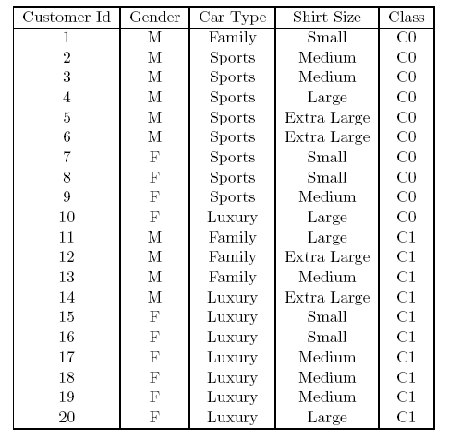
Best Split in Decision Trees
Before Splitting: 10 records of class 0, 10 records of class 1
Node splitting, or simply splitting, is the process of dividing a node into multiple sub-nodes to create relatively pure nodes.
There are multiple ways of doing this, which can be broadly divided into two categories based on the type of target variable.
Continuous Target Variable
Reduction in Variance
Categorical Target Variable
Gini Impurity
Information Gain
Chi-Square
Which test condition is the best?
Notes:
https://www.analyticsvidhya.com/blog/2020/06/4-ways-split-decision-tree/
Pearson's chi-squared test is used to determine whether there is a statistically significant difference between the expected frequencies and the observed frequencies in one or more categories of a contingency table.
In the standard applications of this test, the observations are classified into mutually exclusive classes. If the null hypothesis that there are no differences between the classes in the population is true, the test statistic computed from the observations follows a χ² frequency distribution. The purpose of the test is to evaluate how likely the observed frequencies would be assuming the null hypothesis is true.

Slide 11
Measures of Node Impurity
The node impurity is a measure of the homogeneity of the labels at the node. Gini impurity and Entropy are used for classification.
Finding the Best Split
Compute impurity measure (P) before splitting
Compute impurity measure (M) after splitting
Compute impurity measure of each child node
M is the weighted impurity of children
Choose the attribute test condition that produces the highest gain
or equivalently, lowest impurity measure after splitting (M)
Gini Index
Entropy
Misclassification error
(NOTE: p( j | t) is the relative frequency of class j at node t).
Gain = P – M
Notes:
The node impurity is a measure of the homogeneity of the labels at the node. The current implementation provides two impurity measures for classification (Gini impurity and entropy) and one impurity measure for regression (variance).

Slide 12
Measure of Impurity GINI
Gini Index for a given node t
(NOTE: p( j | t) is the relative frequency of class j at node t).
Maximum (1 - 1/n_{c}) when records are equally distributed among all classes
Minimum (0.0) when all records belong to one class
For 2-class or binary problem (p, 1 – p)
GINI = 1 – p² – (1 – p)² = 2p (1 – p)
P(C1) = 0/6 = 0 P(C2) = 6/6 = 1
Gini = 1 – P(C1)² – P(C2)² = 1 – 0 – 1 = 0
P(C1) = 1/6 P(C2) = 5/6
Gini = 1 – (1/6)² – (5/6)² = 0.278
P(C1) = 2/6 P(C2) = 4/6
Gini = 1 – (2/6)² – (4/6)² = 0.444
P(C1) = 3/6 P(C2) = 3/6
Gini = 1 – (3/6)² – (3/6)² = 0.5

Slide 13
Calculation of Gini Index
When a node p is split into k partitions (children)
where, n_{i} = number of records at child i
n = number of records at parent node p
Choose the attribute that minimizes weighted average Gini index of the children
The above-mentioned generalized formula can be used for two or more splits.
Gini index is used in decision tree algorithms, such as CART, SLIQ and SPRINT.

Slide 14
Calculation of Gini Index Binary Attributes
Splits into two partitions
Effect of Weighing partitions:
Larger and Purer Partitions are sought for
P(C1) = 7/12 P(C2) = 5/12
Gini = 1 – (7/12)² – (5/12)² = 0.486
B?
Yes
No
Node N1
Node N2
Gini(N1) = 1 – (5/6)² – (1/6)² = 0.278
Gini(N2) = 1 – (2/6)² – (4/6)² = 0.444
Weighted Gini of N1 N2 = 6/12 * 0.278 + 6/12 * 0.444 = 0.361
Gain = 0.486 – 0.361 = 0.125
Notes:
6/12 means
5 + 1 = 6
2 + 4 = 6
5 + 1 + 2 + 4 = 12

Slide 15
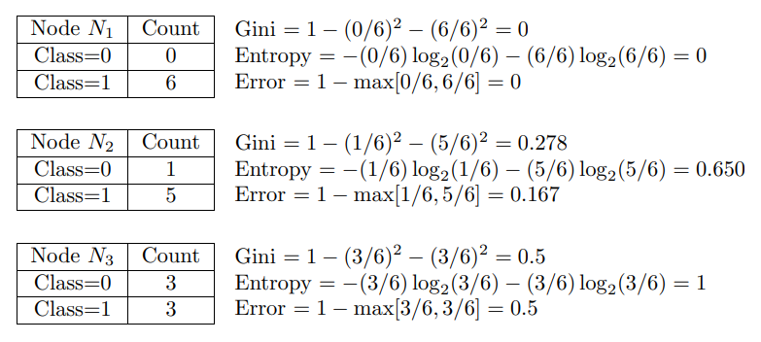
Calculation of Error Single Node
Classification error at a node t
Maximum (1 - 1/n_{c}) when records are equally distributed among all classes, implying least interesting information
Minimum (0) when all records belong to one class, implying most interesting information

Slide 16
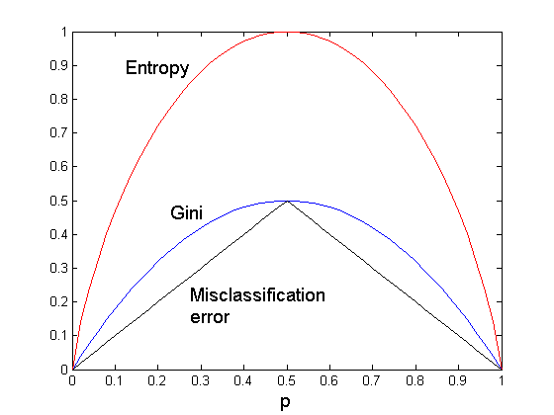
Comparison Impurity Measures
For a 2-class problem:
The Gini Index and the Entropy have two main differences
Gini Index has values inside the interval [0, 0.5] whereas the interval of the Entropy is [0, 1].
Misclassification error has also values in the interval [0, 0.5].

Slide 17
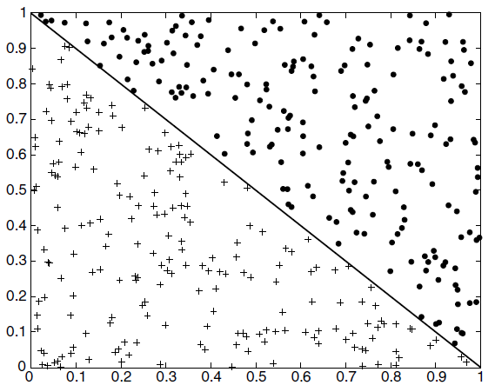
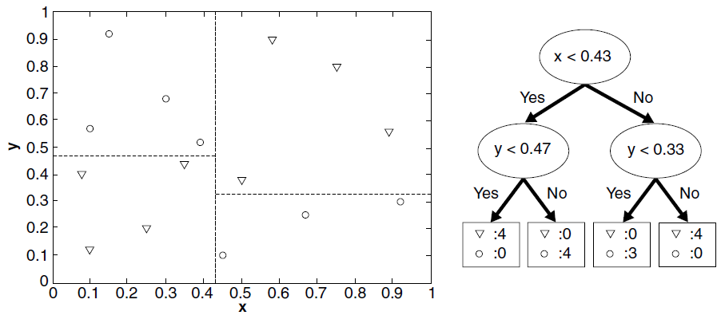
Limitations of Single Attribute-based Decision Boundaries
Example of data set that cannot be partitioned optimally using test conditions involving single attributes.
Example of a decision tree and its decision boundaries for a two-dimensional data set.
Notes:
Consider that you want to divide a one-dimensional dataset of people's ages into two categories: "Young" and "Old." However, because of the age distribution, there is a significant amount of overlap between the two classifications. For example, Ages between 20 and 35 comprise the "young" class. Ages between 30 and 60 comprise the "Old" class. It is difficult to determine the best split in this dataset if you try to use a single threshold or test condition on age to divide the two classes: If you set the cutoff at 35, some people who are considered "Young" will actually be considered "Old.“ If you use 30 as the cutoff, some people who are considered "Old" will actually be considered "Young."

Slide 18
Requirements for using Decision Trees
Decision Tree is supervised classification method
The target variable must be categorical
Pre-classified target variable must be included in the training set
Decision trees learn by example, so training set should contain records with varied attribute values
If the training set systematically lacks definable subsets, classification becomes problematic
There are different measures for leaf node purity
Classification and Regression Trees (CART) and C4.5 are two leading algorithms used in the machine learning
Notes:
Information Gain
C4.5’s uses Information Gain
gain(S) = H(T) – HS(T)
Represents increase in information by partitioning training data T according to candidate split S
For each candidate split, C4.5 chooses split that has maximum information gain, gain(S)
Example
C4.5 illustrated with example
CART algorithm uses Gini Index criterion to split a node to a sub-node. It start with the training set as a root node, after successfully splitting the root node in two, it splits the subsets using the same logic & again split the sub-subsets, recursively until it finds further splitting will not give any pure sub-nodes or maximum number of leaves in a growing tree or termed it as a Tree pruning.

Slide 19
Classification and Regression Trees Pruning
In machine learning, pruning is a data compression technique that shrinks the size of decision trees by eliminating parts of the tree that are unnecessary and redundant for classifying instances.
Pruning is a method for getting rid of the Decision Tree's components that keep it from developing to its maximum depth. The portions of the tree that lack the ability to classify instances are the portions that are removed. Pruning is crucial because training a decision tree to its maximum depth will certainly result in overfitting the training set.
To put it simply, Decision Tree Pruning aims to build an algorithm that performs worse on training data but performs better on test data in terms of generalization. There are two common strategies to prevent overfitting
Stopping the creation of the tree early (also called pre-pruning)
Building the tree but then removing or collapsing nodes that contain little information (also called post-pruning or just pruning).
Possible criteria for pre-pruning include limiting the maximum depth of the tree, limiting the maximum number of leaves, or requiring a minimum number of points in a node to keep splitting it.

Slide 20
Decision Tree Based Classification
Advantages:
Inexpensive to construct
Extremely fast at classifying unknown records
Easy to interpret for small-sized trees
Robust to noise (especially when methods to avoid overfitting are employed)
Can easily handle redundant or irrelevant attributes (unless the attributes are interacting)
Disadvantages:
Space of possible decision trees is exponentially large. Greedy approaches are unable to find the best tree
Does not take into account interactions between attributes
Each decision boundary involves only a single attribute

Slide 21
Ensemble Classifiers
Types of Ensemble Methods
Manipulate data distribution
Example: bagging, boosting
Manipulate input features
Example: random forests
Manipulate class labels
Example: error-correcting output coding
In ML, multiple instances of the same model are trained on various subsets of the training data using the ensemble technique known as bagging (Bootstrap Aggregating), and then the predictions from all of the instances are combined to get the final prediction. The procedure of bootstrapping is used to produce the data subsets from random sampling with replacement.
In boosting, the weak learners are instructed one after the other while concentrating on the errors of the prior learners. In boosting, each repetition gives the misclassified cases more weight.

Slide 22
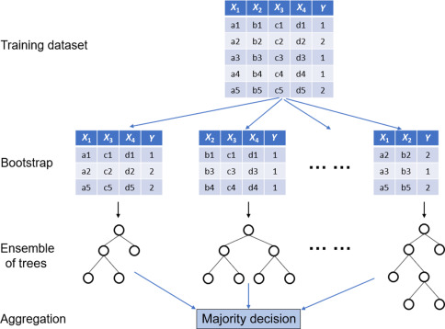
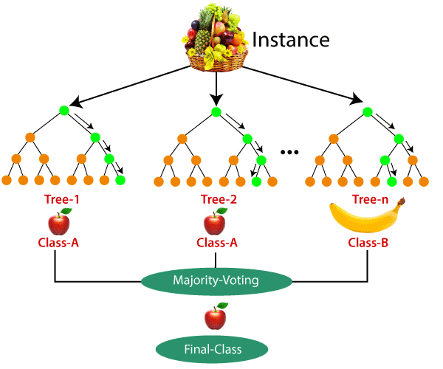
Random Forest
Random Forest is a supervised learning algorithm. It can be used both for Classification and Regression.
A forest is comprised of trees. It has been observed that more trees can form a forest rapidly.
Random forest creates decision trees on randomly selected data samples, gets prediction from each tree and selects the best solution by means of voting.
It also provides a pretty good indicator of the feature importance.
Random forests have a variety of applications, such as recommendation engines, image classification and feature selection.
It can be used to classify loyal loan applicants, identify fraudulent activity and predict diseases.
Notes:
The Boruta algorithm is a wrapper built around the random forest classification algorithm. It tries to capture all the important, interesting features you might have in your dataset with respect to an outcome variable. First, it duplicates the dataset, and shuffle the values in each column.
The sklearn.ensemble module includes two averaging algorithms based on randomized decision trees: the RandomForest algorithm and the Extra-Trees method. Both algorithms are perturb-and-combine techniques [B1998] specifically designed for trees. This means a diverse set of classifiers is created by introducing randomness in the classifier construction. The prediction of the ensemble is given as the averaged prediction of the individual classifiers.

Slide 23
Random Forest Example
Suppose you want plana trip and you would like to travel to a specific destination but not sure.
How to find a place that you will like? You can search online, read reviews on travel blogs and portals, or you can also ask to your friends.
Let’s suppose you have decided to ask your friends and talked with them about their past travel experience to various places. You will get some recommendations from every friend. Now you have to make a list of those recommended places. Then, you ask them to vote (or select one best place for the trip) from the list of recommended places you made. The place with the highest number of votes will be your final choice for the trip.
In the above decision process, there are two parts. First, asking your friends about their individual travel experience and getting one recommendation out of multiple places they have visited.
This part is like using the decision tree algorithm. In this scenario, each friend makes a selection of the places he or she has visited so far.
The second part, after collecting all the recommendations, is the voting procedure for selecting the best place in the list of recommendations. This whole process of getting recommendations from friends and voting on them to find the best place is known as the random forest algorithm.

Slide 24
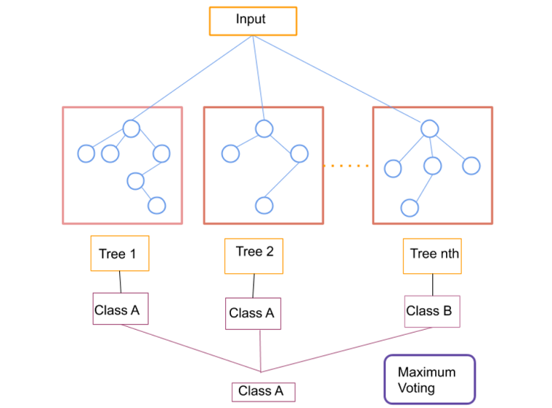
Random Forest Algorithm
It works in four steps
Select random samples from a given dataset.
Construct a decision tree for each sample and get a prediction result from each decision tree.
Perform a vote for each predicted result.
Select the prediction result with the most votes as the final prediction.
Random Forests vs Decision Trees
Random forests is a set of multiple decision trees.
Deep decision trees may suffer from overfitting, but the random forests prevent overfitting by creating trees on random subsets.
Decision trees are computationally faster.
Random forests is difficult to interpret, while a decision tree is easily interpretable and can be converted to rules.

Slide 25
Resources/ References
Introduction to Data Mining, 2nd Edition, Pang-Ning Tan, Michael Steinbach, Anuj Karpatne, Vipin Kumar, 2019, Pearson.
Introduction to Machine Learning with Python, Andreas C. Müller and Sarah Guido, O'Reilly Media, Inc. October 2016.
Data Mining And Machine Learning, Fundamental Concepts And Algorithms, MOHAMMED J. Zaki, Wagner Meira, Jr., Cambridge CB2 8BS, United Kingdom, 2020.
Discovering Knowledge In Data: An Introduction To Data Exploration, Second Edition, By Daniel Larose And Chantal Larose, John Wiley And Sons, Inc., 2014.
UCI Repository: http://www.ics.uci.edu/~mlearn/MLRepository.html
Statlib: http://lib.stat.cmu.edu/
Some images are used from Google search repository (https://www.google.ie/search) to enhance the level of learning.
Copyright Notice The following material has been communicated to you by or on behalf of CCT College Dublin in accordance with the Copyright and Related Rights Act 2000 (the Act). The material may be subject to copyright under the Act and any further reproduction, communication or distribution of this material must be in accordance with the Act. Do not remove this notice

